Slide 1
https://powercybertestbed.ece.iastate.edu/

Slide 2
Week 10/30

Slide 3
Overview of Work
Discussed getting a basic grid worked out with Tommy and Matt
Worked on attempting the SYN flood
Got dss-python to work
Working on attack webpage
Fixed HELICS Docker

Slide 4
Work - Tyler
Still working on syn flood lab environment. Ran into the snag where syn flood does not work as a DoS attack. This means one node (i.e one Kali VM) will not be able to send enough traffic to a port to overload it with connections. Currently looking into Docker configurations to see if we could manufacture the specs to be lower end so that we can overload it easier.
Question: could we possibly have more than 1 Kali VM to try our hand at a DDoS? Or are we limited to the 1 Kali VM?
Will start looking into creating malware scripts to show off a Solarwinds attack
Fun fact, the CISO of Solarwinds was recently found guilty and charged for his mishandling of the situation! :D
Also, we could simulate an eternal blue attack if we have Windows anywhere in the network. I can show case that if we are interested.

Slide 5
Work - Zach
Worked on getting a web server running to plug and play attacks from a python file
Questions:
Do I need to be using Flask like the other webserver?
I have a weirdly specific error that for the life of me can't figure out

Slide 6
Work - Justin
I experimented more with different types of Docker containers
Alpine being the most notables - it was working pretty well.
I realized that this was still overkill for what was needed.
Used Python to make it much more simple
Docker will handle Operating System-like tasks such as ports

Slide 7
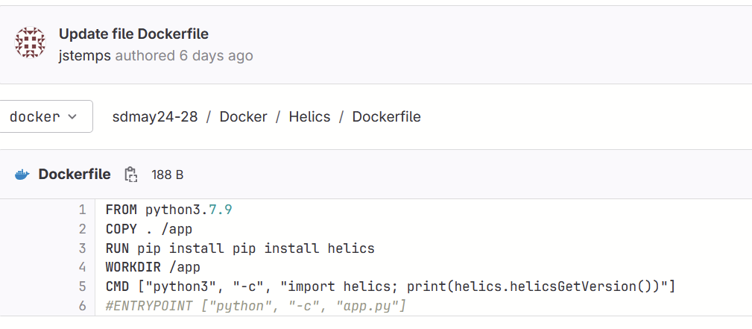
Work - Justin

Slide 8
Work - Justin
Did some research on how to attack Dockerized Python Environments
https://beaglesecurity.com/blog/article/docker-container-security.html
https://www.hackingarticles.in/docker-for-pentester-pentesting-framework/
https://www.cobalt.io/blog/pentesting-containers-overview-security-best-practices

Slide 9
Work - Kaya
Experimented again with dss-python, had a directory issue that I fixed.
It can’t find GLIBCXX, but it does exist, possibly a path redirect issue. Nodes popped up though.

Slide 10
Work - Kaya
Helics ran without issues this time
Never finished, but probably because pandapower and dss aren’t working off of each other
Question: What results are we wanting? Graph output? Text?

Slide 11
Work - Kaya
Dss_python code
Question: is this always what we’re going to use? Documentation is lacking and all I can find is this example of running code. No idea what lines 4-8 do.
https://github.com/dss-extensions/dss_python/blob/master/docs/examples/JSON.ipynb
https://github.com/dss-extensions/dss_python/blob/master/docs/examples/Plotting.ipynb

Slide 12
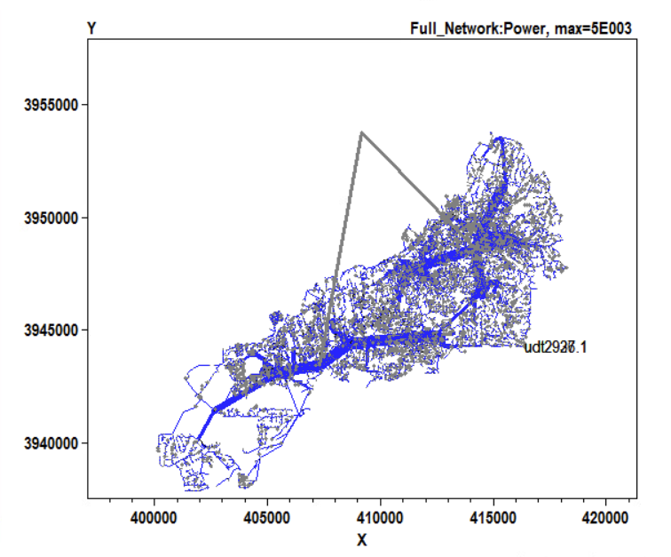
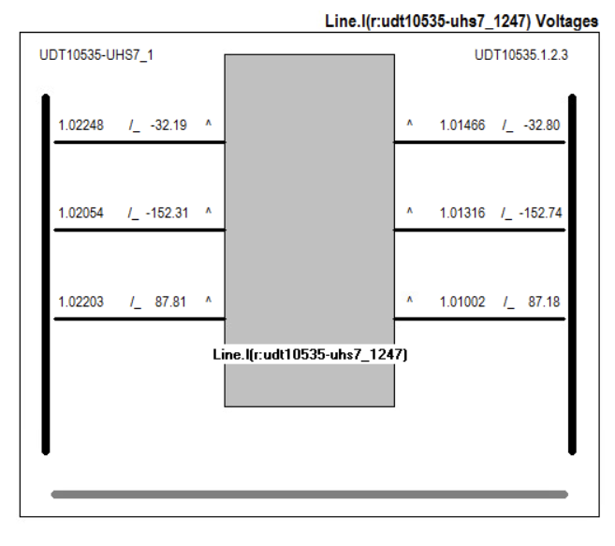
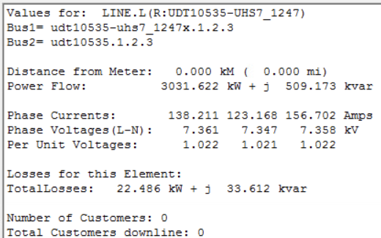
Work-Matt & Tommy
OpenDSS
Santa Fe Power Plot
Thicker the line = more power on a scale of 5000 VARS
Can click on various lines and see the voltage, current, and powers models along with phasors of each phase on a model
More valuable to see results tab

Slide 13
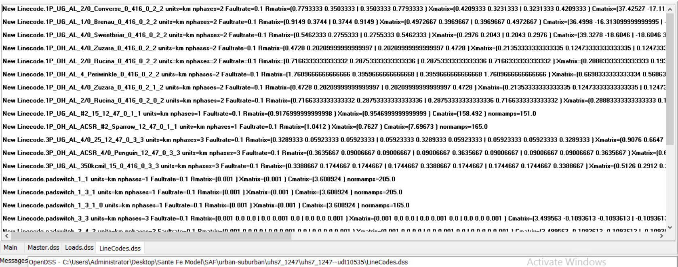
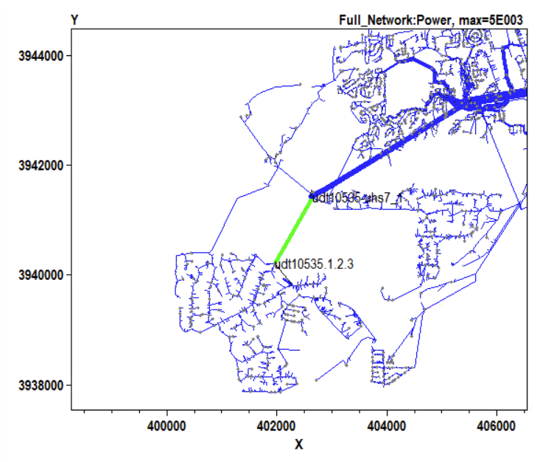
Work-Matt & Tommy
Using the naming convention of the line within the power model was able to find and open the line codes and loads on the line
Confused of the data within the line creation code

Slide 14
Matt/Tommy Questions
Is DSS_python the same as OpenDSS on windows interface wise? Talked with Kaya and to her understanding we can only upload and run an existing file in Ubuntu. Sounds like we can’t create our own coded distribution system?
Do we have the correct version of PandaPower? Can we write code for our transmission model?

Slide 15
Next Week
Work some more on the Docker containers
Get mainly get HELICS to work with other Dockers (PandaPower and DSS_Python)
Add more documentation to the sdmay24-28 website
Write the Testing Document and Lightning talk
Continue working on the Flask frontend
Possibly get a basic pandapower-to-dss grid layout created

